Slide 1
Sybase and Eclipse
Feb, 2002
Karl Reti

Slide 2

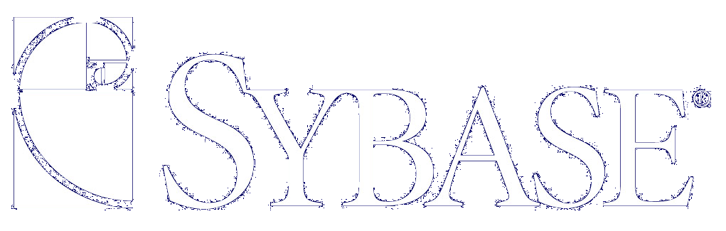
Sybase
Mission Statement
Today Sybase offers the industry’s most comprehensive software platform for open, modular, integrated e-Business, which will result in broad-based market adoption and a leadership position in the e-Business infrastructure market by 2003.
Notes:
Sybase is a global, billion-dollar company that excels in the e-Business infrastructure that companies need to do business on the Web. What we are is best reflected through our customers.
Wall Street runs on Sybase. We are the infrastructure standard, with 2/3 or 68% of the companies that develop applications for Wall Street use open our e-Business infrastructure software. One such example is Bear Stearns.
Bear Stearns Global Clearing Services is a leader in providing full securities clearing services for the past 26 years. Analysts are projecting that their transaction volume will grow 150% per year over the next 5 years. In response to the increase in transaction volume, they have a corresponding decrease in the time allowed for batch windows to clear the trades. Using Sybase Adaptive Server Enterprise and professional services they have decreased the batch window over an order of magnitude (less than 5 minutes) so they can better meet their market demands.
Another example is with Federal Express. Our e-Business Infrastructure expertise lets FedEx handle 800 million of 1.2 billion Web interactions a year, saving it from hiring 20,000 more employees. Our most famous example is World Cup Soccer. When developing sporting event applications, the application has a very short life span therefore having no political software affiliation. World Cup Soccer Association choose Sybase e-Business infrastructure to deliver their highly visible application. During that 4 week period in 1998, our web product scored the most hits in one day, in one hour and a shattering 235, 356 hits in just 60 seconds. This record still stands today in the Guinness Book of World Records. It is amazing that even after the Olympics, Sybase still holds this Internet record.
In fact, 95 of the Fortune 100 use Sybase Products.
Our technology expertise over the past 16 years drives our capacity to make powerful open products and solutions that meet -- and grow with -- the demands of the Web.
We take entire businesses to the Web 100 percent – customers, suppliers, procurement, orders – everything, in substantially less time and cost than our competitors.

Slide 3
Karl Reti
Biography
Sybase (00 – Present)
  Director of Engineering, platform architecture
    Responsible for Sybase's e-Business Platform Architecture and Tooling Strategy
New Era of Networks (99 – 00)
  VP of Engineering, UI and Tools group
    EAI and e-Business Products and UI Tooling
    Revamped User Interface for entire suite of New Era Products
MicroScript (96 – 99)
  CTO
    Led development of market leading EAI product suite
    MicroScript products were universally accepted as the easiest to use EAI products in the market
ICS Ltd (UK) (87 – 96)
  Director of Technology
    Designed and developed market leading medical and EAI technology

Slide 4
Sybase commercial use of Eclipse
Sybase will use Eclipse for Design, Development and Deploy time Tooling in the next versions of our eBusiness platform products.
This will result in increased adoption of Eclipse and wider recognition for Eclipse as the ubiquitous IDE.
Power
Designer
Enterprise Portal - Web & Mobile Access
Access
Develop
Biz
Tracker
Integration
Server
Process
Server
Application
Adapters
Web
Services
Integrate
PowerJ
Application
Server
Business
Intelligence
Replication
Database
Transact
Metadata Repository - Configuration
Security - Install - Management
SYBASE e-Business Platform

Slide 5
Sybase internal use of Eclipse
Actions
Results
Sybase will use Eclipse internally for all Eclipse related development and plug-in development.
Sybase will leverage Eclipse internally as a Java development environment.
Eclipse will become a vital strategic solution for Sybase.
We will be strongly motivated to actively extend and strengthen Eclipse from both a commercial and development perspective.

Slide 6
Summary
Sybase has chosen Eclipse as a strategic direction.
Sybase will adopt Eclipse in the next versions of our eBusiness Platform products.
Sybase is motivated to drive the acceptance and success of Eclipse.
Sybase is intent on playing an active role in the further enhancement and strategic direction as a Steward Member of Eclipse.org.
Sybase will publicly announce our adoption of Eclipse and our Eclipse affiliation.

